Slide 1
Week 7 –
Object Oriented Programming
Microsoft Interview Coaching Program

Slide 2
Agenda
TEBOW IT review of last week’s homework
Object Oriented Design
Classroom problem: CreditUnion
This week’s homework: VendingMachine

Slide 3
TEBOWIT – Subtree of Another Tree

Slide 4
Subtree of Another Tree
Given two non-empty binary trees s and t, check whether tree t has exactly the same structure and node values with a subtree of s. A subtree of s is a tree that consists of a node in s and all of that node's descendants.

Slide 5
T – Talk (/Listen/Clarify)
Question | Answer
Are s and t binary search trees? | No
Can the trees have duplicate values? | Yes
What are my inputs? | 2 Node pointers. One is the root of tree s, the other is the root of tree t
Do I need to create my own Node class? | No
What information does a Node object hold? | Two Node pointers (left and right), and an int to hold data
What should be returned? | True if t has the same structure and node values as a subtree of s, false otherwise
Can s have fewer nodes than t? | No
How should I handle null input? | Discuss. Interviewer informs you that an empty tree is a subtree of any tree => return true if t is null

Slide 6


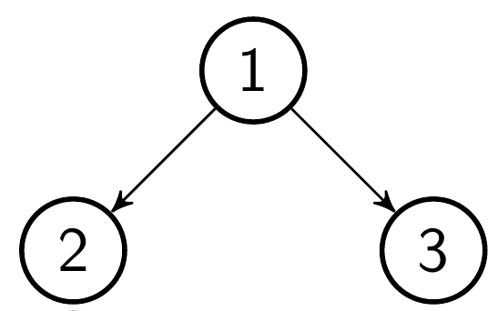
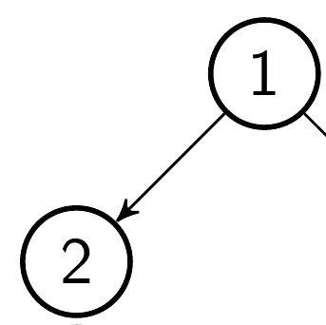

E – Examples (/Test/TDD)
Sample s | Sample t | Equivalence Class | Output
null | null | Null t, null s | True
 | null | Null t, non-empty s | True
null |  | Null s, non-empty t | False
 |  | Simple success | True
 |  | Simple failure | False
 |  | Simple multi-element success | True
 |  | Root match + simple value mismatch | False

Slide 7

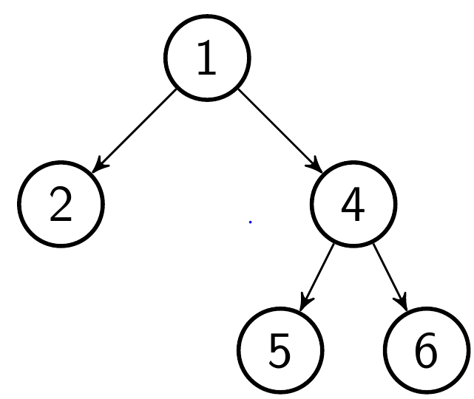
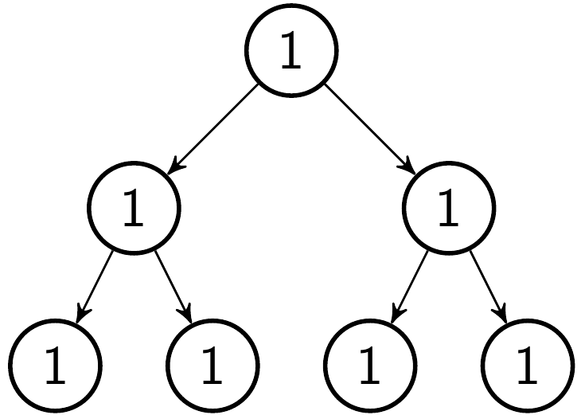

E – Examples (/Test/TDD)
Sample s | Sample t | Equivalence Class | Output
 |  | Matching subtree not at root of s | True
 |  | Mismatched at leaf level (t ends early) | False
 |  | Mismatched at leaf level (s ends early) | False
 |  | Evil? Lots of partial matches, but no complete match | False

Slide 8
B – Brute Force
Create string representations of the traversals of each tree
If t is a subtree of s, then its string representation will be a substring of s’s

Slide 9
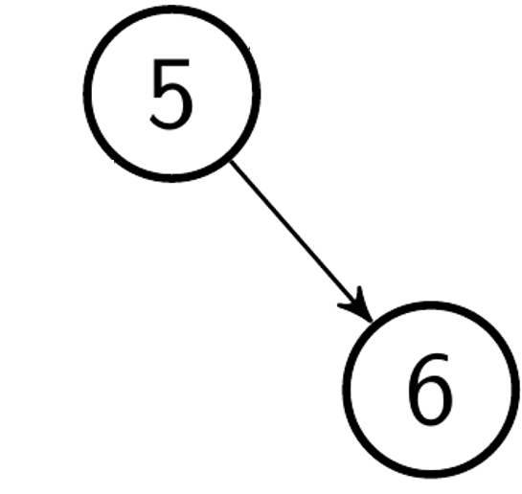
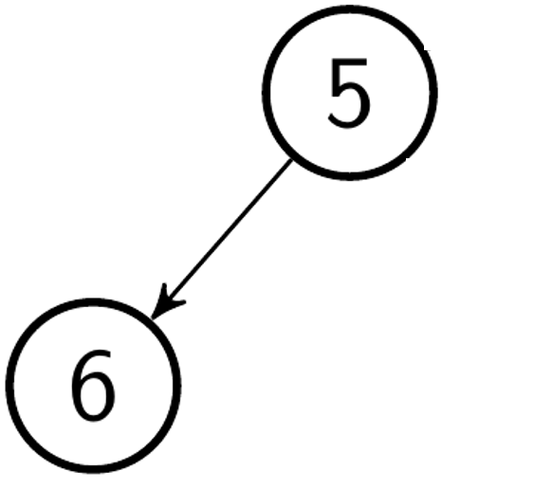
Toolbox
How can you guarantee that a string representation of a tree traversal tree can be uniquely matched to a particular tree?
In-order traversal?
Same values will always have same order, even if structure is different
What about pre-order?
More promising, but not without pitfalls…
Ok… so how do we guarantee uniqueness?
5, 6
5, 6

Slide 10
Toolbox
How can you guarantee that a string representation of a tree traversal tree can be uniquely matched to a particular tree?
In-order traversal?
Same values will always have same order, even if structure is different
What about pre-order?
More promising, but not without pitfalls…
Ok… so how do we guarantee uniqueness?
Store null nodes as a special character (‘X’)
5, X, 6, X, X
5, 6, X, X, X
Notes:
As the pre-order traversal starts at the root and the path taken is entirely dependent on the traversal => two trees are identical if they have the same pre-order traversal as long as null nodes are specified

Slide 11
public static bool IsSubtree(TreeNode s, TreeNode t)
{
StringBuilder sSB = new StringBuilder();
StringBuilder tSB = new StringBuilder();
BuildPreOrderString(s, sSB);
BuildPreOrderString(t, tSB);
String sRep = sSB.ToString();
String tRep = tSB.ToString();
return sRep.Contains(tRep);
}
public static void BuildPreOrderString(TreeNode node, StringBuilder sb)
{
if (node == null)
{
sb.Append("X");
}
else
{
sb.Append(node.data + " ");
BuildPreOrderString(node.left, sb);
BuildPreOrderString(node.right, sb);
}
}
Notes:
Why are we adding the space after the current node? (to-do: describe example tree)

Slide 12

Complexity
Time: O$\left(n+m\right)$
Space: O$\left(n+m\right)$
Where n and m are number of nodes in s and t respectively

Slide 13
Interview Curveball
“Great! It turns out that we’re going to need the function to support millions of nodes though, can you do it with less space?”

Slide 14
Handling Curveballs
Interviewers love seeing how you react to pressure
Don’t panic ☺
Take the time to think things through
When thrown a curveball, sometimes you can come up with an algorithm that’s strictly better than your current approach, but typically you’re looking at a trade-off
Be prepared to discuss the Big O of both your original solution and the new approach

Slide 15

O – Optimize (Space)
The pre-ordered string approach requires O$\left(n+m\right)$ space and time
Can you solve the same problem with less space and more time?

Slide 16
Approach 2
Search through s
Each time the root of t matches a node in s, walk the two trees in the same way at the same time
If they’re equal in value/structure for the remainder of t, return true
If they’re unequal in value/structure at any point return false
If we’ve returned true at any point while walking all nodes in s then t has a matching subtree in s, return true
If we’ve checked all of s and found no valid subtree, return false

Slide 17
I – Implement

Slide 18
public static bool IsSubtree(TreeNode s, TreeNode t) {
if (t == null) {
return true;
}
return ContainsTree(s, t);
}
public static bool ContainsTree(TreeNode s, TreeNode subtreeCandidate) {
if (AreEqual(s, subtreeCandidate)) {
return true;
}
return (s != null) &&
(ContainsTree(s.right, subtreeCandidate) || ContainsTree(s.left, subtreeCandidate));
}
public static bool AreEqual(TreeNode t1, TreeNode t2) {
if (t1 == null && t2 == null) {
return true;
} else if (t1 == null || t2 == null) {
return false;
}
if (t1.data == t2.data) {
return AreEqual(t1.left, t2.left) && AreEqual(t1.right, t2.right);
}
return false;
}

Slide 19

Complexity
Space: O$(\log\left(n\right)+log⁡(m))$
Time: O$(nm)$
Notes:
Time complexity is O(nm)… or is it?

Slide 20
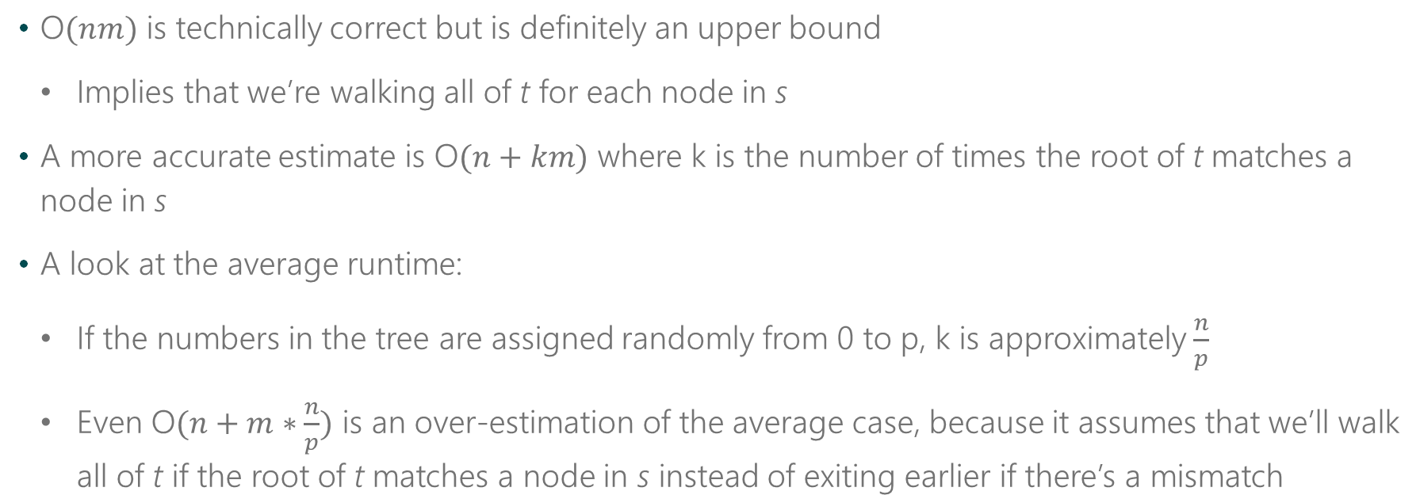
A Closer Look at Time Complexity
O$(nm)$ is technically correct but is definitely an upper bound
Implies that we’re walking all of t for each node in s
A more accurate estimate is O$(n+km)$ where k is the number of times the root of t matches a node in s
A look at the average runtime:
If the numbers in the tree are assigned randomly from 0 to p, k is approximately $\frac{n}{p}$
Even O$(n+m∗\frac{n}{p})$ is an over-estimation of the average case, because it assumes that we’ll walk all of t if the root of t matches a node in s instead of exiting earlier if there’s a mismatch

Slide 21
So… which is better?
It’s all about trade-offs and choosing what should be prioritized

Slide 22
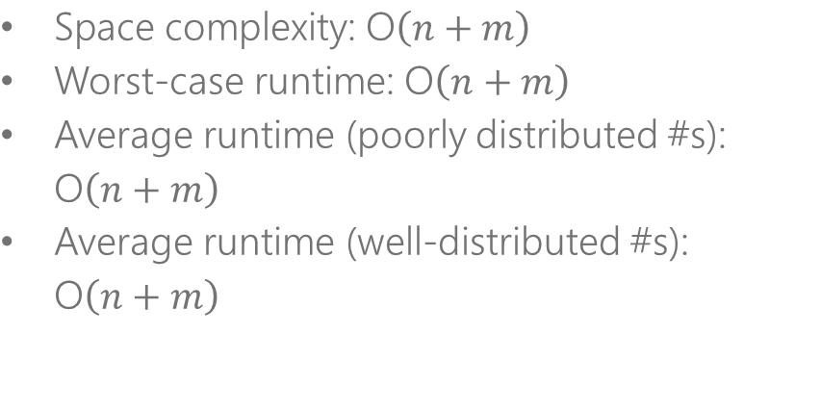
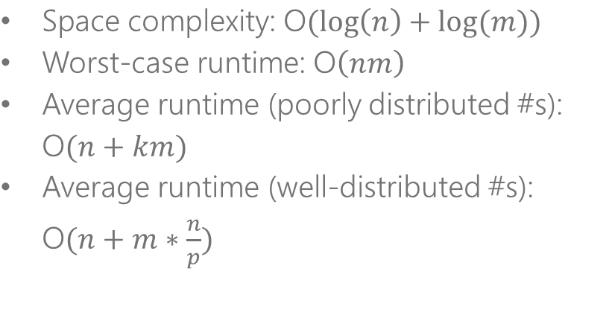
Complexity Comparison
Pre-Order Traversal String-Matching
Walk s and Compare to t
Space complexity: O$\left(n+m\right)$
Worst-case runtime: O$\left(n+m\right)$
Average runtime (poorly distributed #s): O$\left(n+m\right)$
Average runtime (well-distributed #s): O$\left(n+m\right)$
Space complexity: O$(\log\left(n\right)+log⁡(m))$
Worst-case runtime: O$\left(nm\right)$
Average runtime (poorly distributed #s): O$(n+km)$
Average runtime (well-distributed #s): O$(n+m∗\frac{n}{p})$
Notes:
Note: if the numbers in the trees are well distributed and p > n, then the runtime of the second approach is actually better than the first.
Being able to discuss the Big O complexities here and occasions where one approach is better than the others will score points with your interviewer

Slide 23
(Object Oriented) Design
Notes:
We talk about design broadly, though OOP is a key principle

Slide 24
Design is…
A wicked problem
A sloppy process
About tradeoffs and priorities
About restrictions
Nondeterministic
A heuristic process
Emergent
Notes:
Code Complete p 75-76
Wicked problem - - one that could be clearly defined only by solving it, or by solving part of it
Sloppy process – you may have many false starts and incorrect solutions before you arrive at a correct one
Tradeoffs/priorities – balance speed, memory, cost, etc.
Restrictions – you don’t have infinite time, resources, space
Nondeterministic – three different people can come up with three different designs
Heuristic – no repeatable process to come up with a design
Emergent – sums it all up, a good design emerges as the result of many activities (reviews, discussions, experience)

Slide 25
Software’s primary technical imperative is managing complexity
Notes:
Much of how we design and write code has to deal with managing complexity

Slide 26
What is good design?
Portability
Leanness
Minimal complexity
Ease of maintenance
Loose coupling
Extensibility
Reusability
High fan-in
Low-to-medium fan-out
Notes:
P 80-81 code complete
Maintenance – think about designing for the “maintenance programmer”
Leanness – a book is finished not when nothing more can be added, but when nothing more can be taken away
High fan-in – many classes use a given class; indicates good code re-use and design
Fan-out – a class shouldn’t have dependencies on many other classes

Slide 27
Public service announcement
“Agile” is not an excuse for bypassing the design process
Notes:
In fact, with open source software becoming more prevalent, it is even more important to have a good design to truly be “agile”

Slide 28
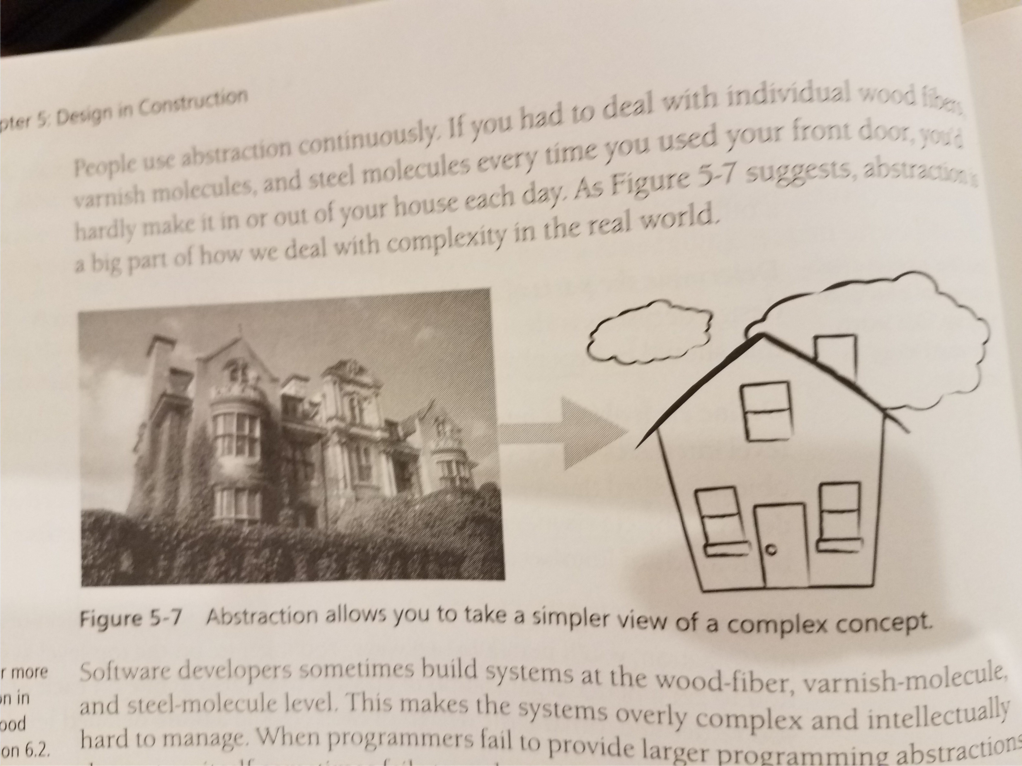
Abstraction

Slide 29
Identify Areas likely to change
Business rules
Hardware dependencies
Input and ouput
Nonstandard language features
Difficult design and construction areas
Status variables
Data size constraints
Notes:
One attribute great designers have in common – their ability to anticipate change
It takes experience to get good at this

Slide 30
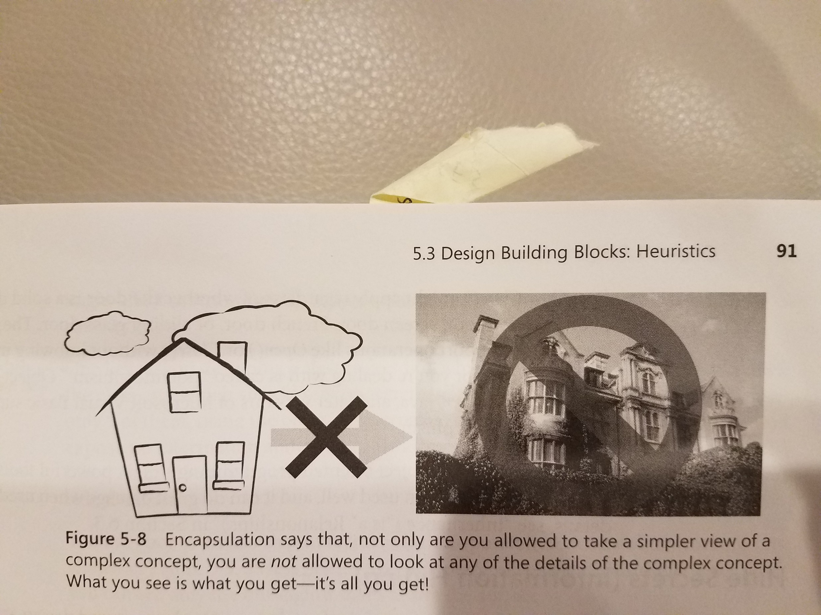
Encapsulation
Notes:
A language mechanism for restricting direct access to some of the object's components.^{[3][4]}
A language construct that facilitates the bundling of data with the methods (or other functions) operating on that data.^{[5][6]}
Encapsulation
Public v Private v Protected
Getters & Setters
Using “this” for clarity

Slide 31
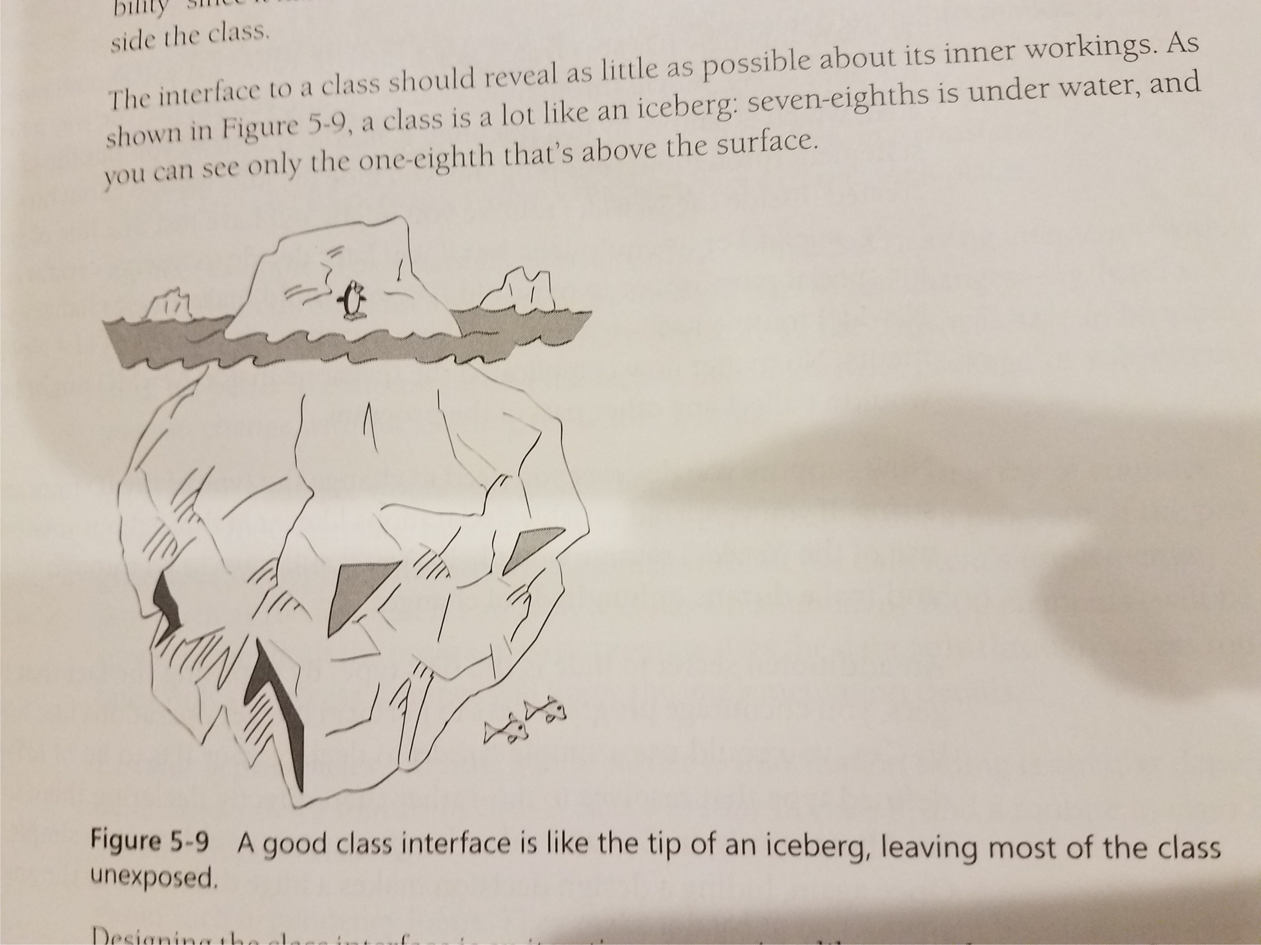
A good class interface

Slide 32
OOP Basics
Programming design approach that organizes code into “objects”
Objects contain 2 fundamental pieces:
State
Behavior
Objects can be related to one another in many ways
Is-a
Has-a

Slide 33
Anatomy of an Object
State
Constructors define starting state
Encapsulation
Public v Private v Protected
Getters & Setters
Using “this” for clarity
Behavior
Public methods
Private methods
Inherited methods
Overridden methods
Overloaded methods

Slide 34
Classes vs. Objects
An object is an instance of a class
Object is an entity that exists at runtime
Class is the code in your program listing

Slide 35
Reasons to create classes
Model real-world objects
Reduce complexity
Example: Streamline parameter passing
Isolate complexity
Hide implementation details
Limit effects of changes
Facilitate reusable code
Notes:
P 152-155 code complete

Slide 36
More OOP
Inheritance
Is your language single or multi-inheritance?
Interfaces
Comparable
Iterable
Abstract Classes & fields
Polymorphism

Slide 37
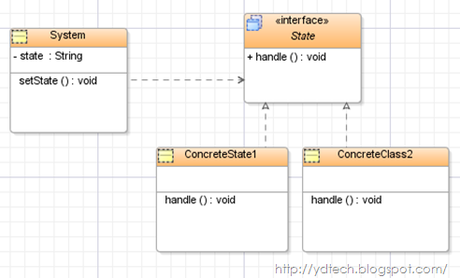
OOP Interview Questions
Can often be VERY open ended
It’s ok to make decisions on behavior, but justify them and ask first
UML diagrams can be very helpful to understand the structure

Slide 38
Example Problem

Slide 39
Credit Union
You are constructing the code that will be used by a small credit union to manage its customers and accounts. There are two types of customers: private individuals and businesses. Customers must have a unique ID associated with them and be able to know the balance of their accounts. The bank must also be able to distinguish between Individuals and Businesses based on their ID. There are two types of accounts: checkings and savings. All customers may have one checking and one saving. The accounts must track all debits, credits to maintain an up to date balance. Each month the balance of savings accounts increases based on their interest rate.

Slide 40
The “six Ws”
Question | Answer
Who is going to use it?
What is it?
Where will it be used?
When will it be used?
How will it be used?
Why will it be used?

Slide 41
T – Talk (/Listen/Clarify)
Question | Answer
What is the expected behavior of private individuals? | Open checking account, open saving account, total balance across all accounts, monthly statement
What is the expected behavior of businesses? | Same as private individuals, but their IDs indicate they are a business.
What is the expected behavior of checking accounts? | Open account with initial deposit, track credits, track debits, give total balance
What is the expected behavior of savings accounts? | Same as checking, but has a given interest rate, which accrues at the end of each month.
How do you know the interest rate of a savings account? | For private individuals it is 1% monthly for businesses it is 2% monthly
What happens if an account goes negative? | Simply maintain a correct balance, another object will deal with ramifications of over drafting
How is a new month triggered? | The bank generates monthly statements for each customer, at that time their savings account interest should accrue

Slide 42
E – Examples (/Test/TDD)
Test code | Behavior
Individual customer1 = new Individual(); | Constructs a new private individual customer object and assigns a unique ID. This customer would have no accounts.
Business customer2 = new Business(); | Constructs a new business customer object and assigns a unique ID. This customer would have no accounts.
customer1.newChecking(500.00); | Creates a new checking account associated with this customer, starts with an initial debit of $500
customer2.newSaving(1000.00, 2); | Creates a new savings account associated with this customer, starts with an initial debit of $1000 and an interest rate of 2%
cutomer2.overallBalance(); | Returns the combined balance of this customer’s accounts as a double
customer1.monthlyStatement() | Updates the customers savings accounts based on interest, after which returns the customers overallBalance

Slide 43
B – Brute Force
Create four classes: Individual, Business, Saving, Checking
Create unique IDs based on time stamp and random number generators
Do not worry about code sharing across classes
Individual
State Id Checkings account Savings account Overall balance
Behavior New checkings New savings Overall balance Monthly statement
Business
State Id Checkings account Savings account Overall balance
Behavior New checkings New savings Overall balance Monthly statement
Saving
State Overall balance Interest rate
Behavior Debit Credit Monthly interest accrue
Checking
State Overall balance
Behavior Debit Credit

Slide 44
Toolbox
How can you maintain complex state within an object?
Use other objects as fields (has-a relationship)
How can you share code between two classes?
Make one class extend the other and add on extra behavior in child class
Create abstract super class both classes inherit from
How can you create a field that is updated at the creation of each new instance of an object?
Abstract field within abstract class

Slide 45
Complexity
How much storage are we using across our objects?
For all our classes storage is very simple, a single double as balance or a couple references to account objects
For the business customer we need a collection of account objects
It is likely there wont be too many accounts per customer- it won’t be too expensive to loop over a simple structure

Slide 46
O – Optimize
Create a shared super class for Individual and Business as well as for Saving and Checking to maximize code usage
Account
State Overall balance
Behavior Debit Credit Get balance Monthly statement
Customer
State Total customer count Checkings account Savings account Overall balance
Behavior New checkings New savings Overall balance Monthly statement
Saving
State Interest rate
Behavior Monthly interest accrue
Checking
State Inherited
Behavior inherited
Individual
State “I” + customerCount
Behavior inherited
Business
State “B” + customerCount
Behavior inherited

Slide 47
W – Walkthrough
Testing code is your friend!
Does each type of customer store a unique ID?
Does each type of customer store their checking account?
Does each type of customer store their savings account?
Does each type of account allow for up to date balances?
Does savings account balance grow?

Slide 48
I – Implement

Slide 49
public abstract class Customer {
private static int customerCount;
protected String id;
protected double overallBalance;
protected Savings savingsAcct;
protected Checkings checkingsAcct;
public Customer() {
customerCount++;
this.overallBalance = 0.0;
this.checkingsAcct = null;
this.savingsAcct = null;
}
public int getCustomerCount() {
return customerCount;
}
public double getOverallBalance() {
return overallBalance;
}
public void newCheckings(double initVal) {
if(this.checkingsAcct == null) {
this.checkingsAcct = new Checkings(initVal);
this.overallBalance += initVal;
}
}
public void newSavings(double initVal) {
if (this.savingsAcct == null) {
this.savingsAcct = new Savings(initVal, 2);
this.overallBalance += initVal;
}
}
}
public class Individual extends Customer {
public Individual(){
super();
this.id="I" + getCustomerCount();
}
}
public class Business extends Customer {
public Business() {
super();
this.id = "B" + getCustomerCount();
}
}

Slide 50
public class Account {
protected double balance;
public Account() {
this(0.0);
}
public Account(double initVal) {
this.balance = initVal;
}
public double getBalance() {
return balance;
}
public double monthlyStatement() {
return getBalance();
}
public void credit(double val) {
this.balance -= val;
}
public void debit(double val) {
this.balance += val;
}
}
public class Checkings extends Account{
public Checkings(double initVal) {
super(initVal);
}
}
public class Savings extends Account {
private int interest;
public Savings (double initVal, int interest) {
super(initVal);
this.interest = interest;
}
public double monthlyStatement() {
this.balance += this.balance * (100/this.interest);
return super.monthlyStatement();
}
}

Slide 51
T – Test

Slide 52
Homework Problem

Slide 53
Problem
https://discuss.leetcode.com/topic/95974/design-a-vending-machine

Slide 54
Challenge Problems
https://discuss.leetcode.com/topic/95654/design-classes-for-deck-of-cards
https://discuss.leetcode.com/topic/96426/design-calculator

Slide 55
Resources
Code Complete 2nd edition, Steve McConnell
Chapters 1 – 6 a MUST READ

